Slide 1
Korea

Slide 2
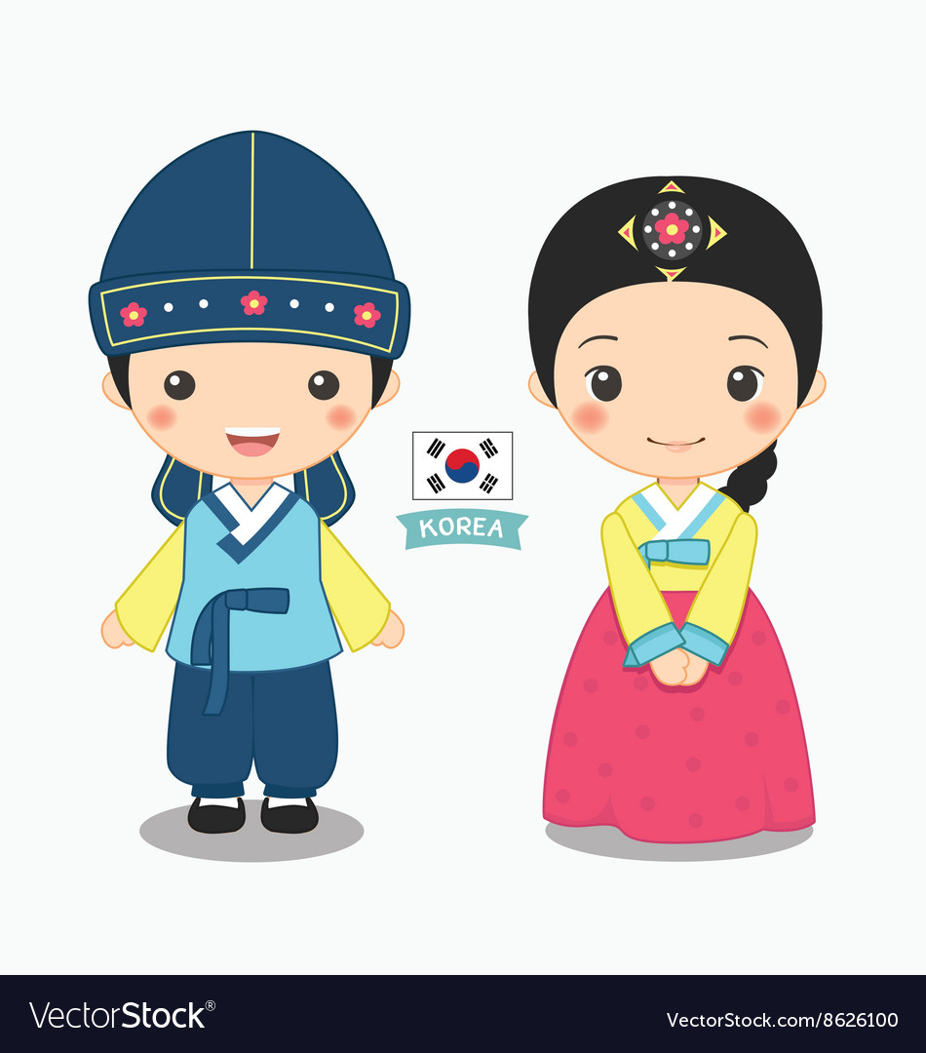
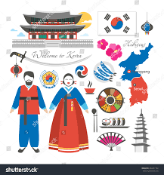
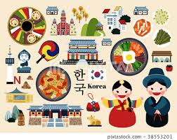
Many years ago, people didn’t live like we do today. They had lots more chores, and they didn’t watch TV or play on computers.

Slide 3
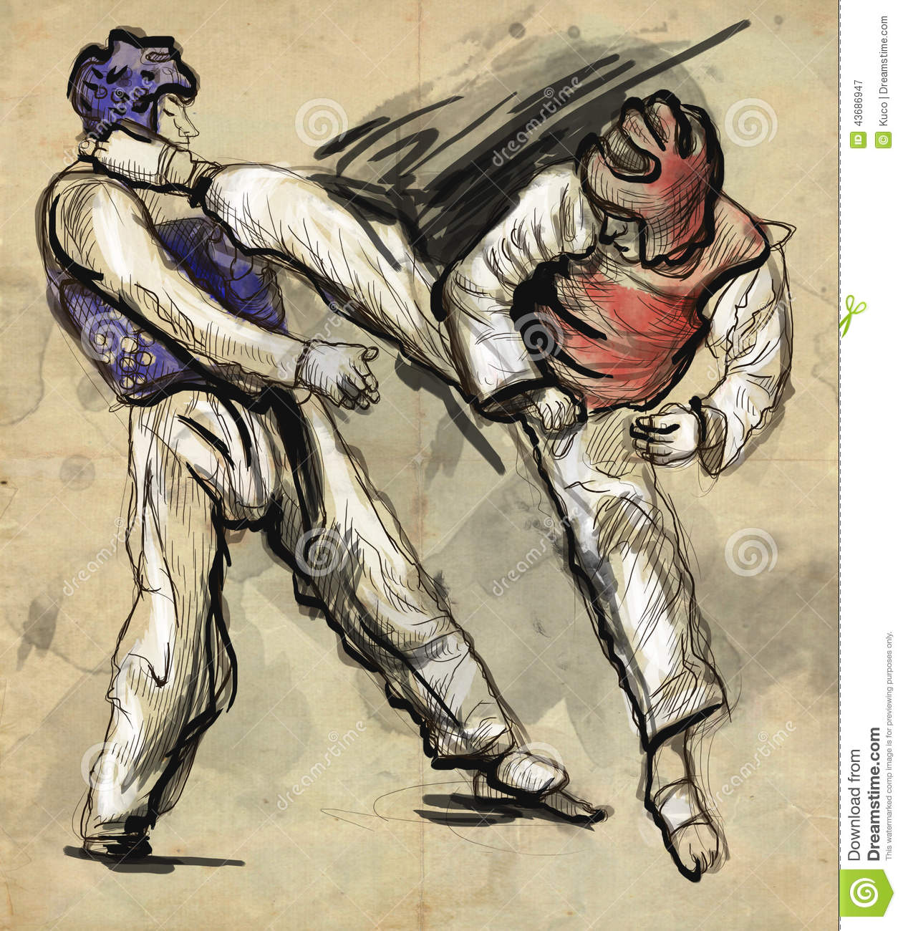
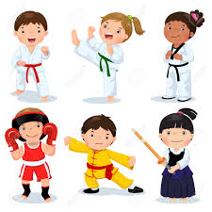
Many people practiced martial arts— but not in their free time. They studied how to fight and defend themselves. Do you know somebody who does taekwondo?

Slide 4
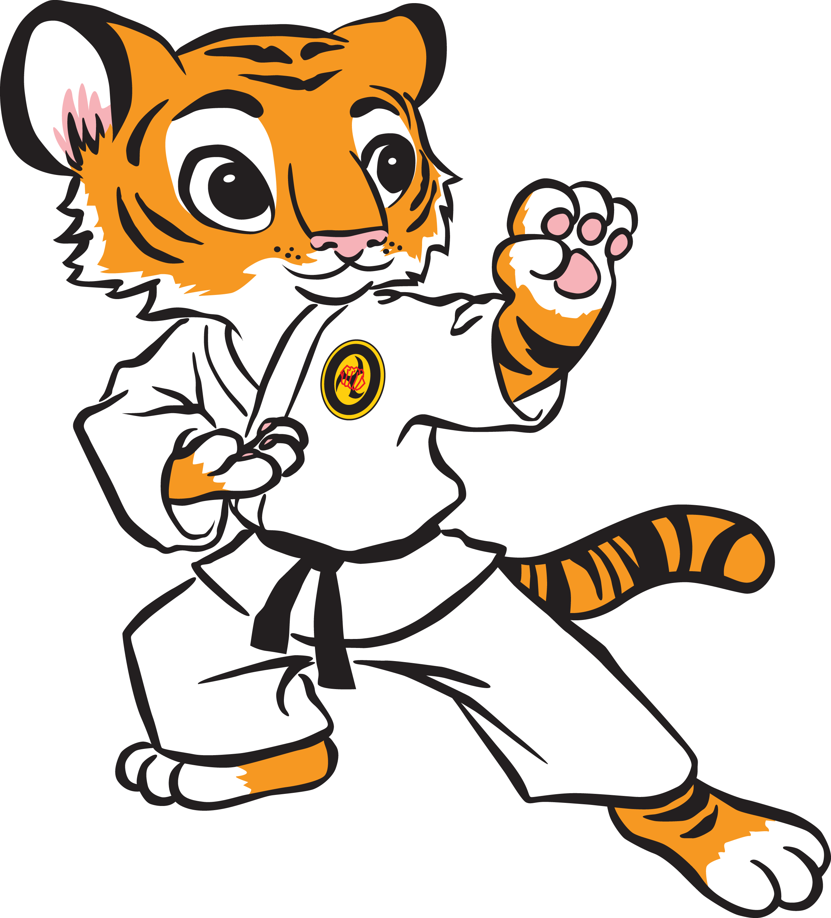
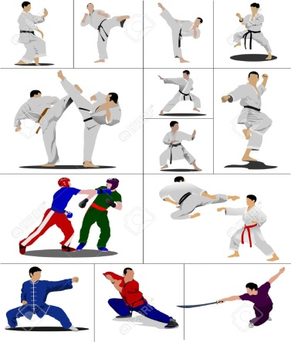
Many people think that this martial art is a very old invention, but, in fact, taekwondo started in the 1960s in Korea. It’s now one of the most popular martial arts in the world.

Slide 5
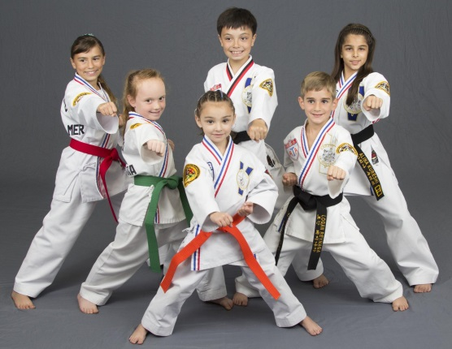
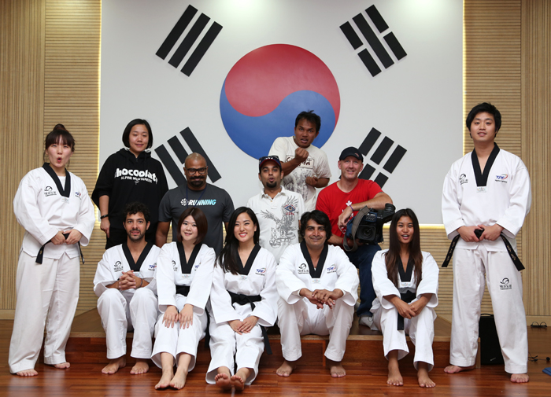
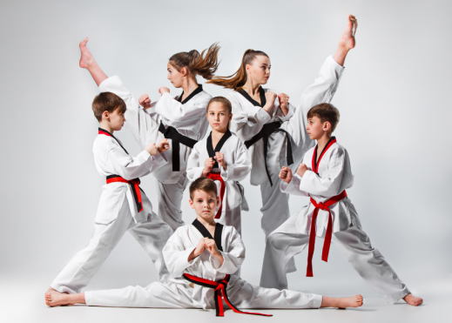
More than 3.5 million people in the world do taekwondo! It’s so popular that in the year 2000 it became an official Olympic sport!

Slide 6
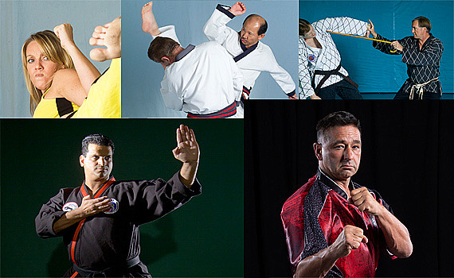
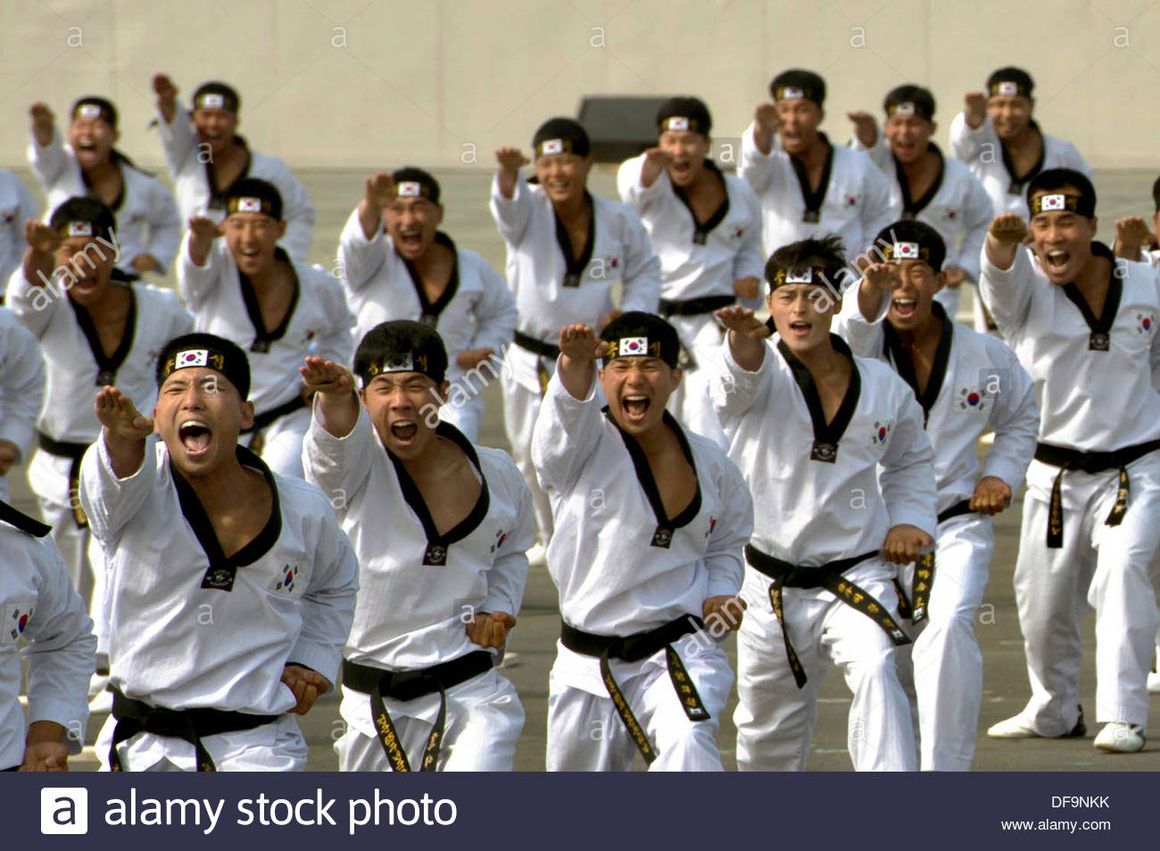
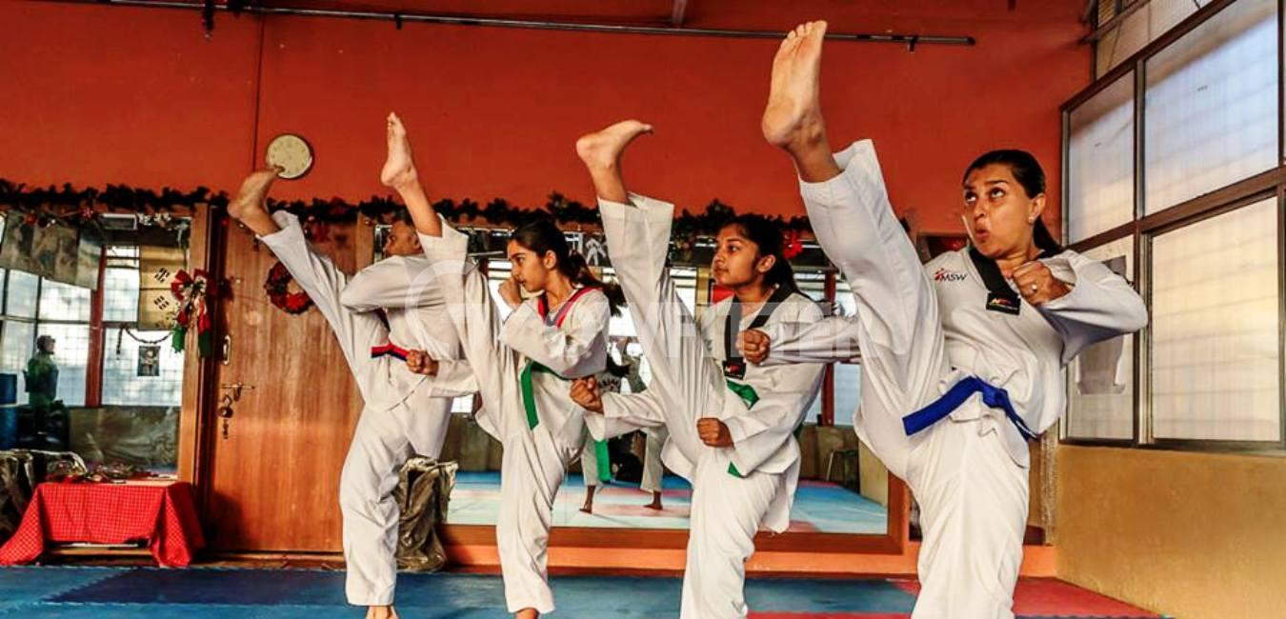
People who teach and study taekwondo also believe that it can be an important part of your life: “Of course you learn self-defense, but you also learn discipline, perseverance, and respect for other people— and it’s a lot of fun!”

